Slide 1
Microsoft Azure Fundamentals
Module 2, Section 3
Dr. Tóth Ádám
toth.adam@inf.unideb.hu

Slide 2
Storage
Notes:
https://learn.microsoft.com/training/modules/describe-azure-storage-services/

Slide 3

Storage accounts
Must have a globally unique name.
Provide over-the-internet access worldwide.
Determine storage services and redundancy options.
Notes:
https://learn.microsoft.com/training/modules/describe-azure-storage-services/2-accounts

Slide 4
Storage redundancy
Redundancy configuration | Deployment | Durability
Locally redundant storage (LRS) | Single datacenter in the primary region | 11 nines
Zone-redundant storage (ZRS) | Three availability zones in the primary region | 12 nines
Geo-redundant storage (GRS) | Single datacenter in the primary and secondary region | 16 nines
Geo-zone-redundant-storage (GZRS) | Three availability zones in the primary region and a single datacenter in the secondary region | 16 nines
Notes:
https://learn.microsoft.com/training/modules/describe-azure-storage-services/3-redundancy

Slide 5
Azure storage redundancy
Azure Storage always stores multiple copies of your data so that it's protected from planned and unplanned events such as transient hardware failures, network or power outages, and natural disasters.
Redundancy options:
How your data is replicated in the primary region.
Whether your data is replicated to a second region that is geographically distant to the primary region, to protect against regional disasters.
Whether your application requires read access to the replicated data in the secondary region if the primary region becomes unavailable.

Slide 6
Redundancy in the primary region
Data in an Azure Storage account is always replicated three times in the primary region.
Two options for how the data is replicated in the primary region:
locally redundant storage (LRS)
zone-redundant storage (ZRS)

Slide 7
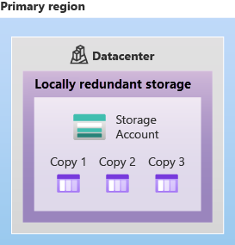
Locally redundant storage
Locally redundant storage (LRS) replicates your data three times within a single data center in the primary region. LRS provides at least 11 nines of durability (99.999999999%) of objects over a given year.

Slide 8
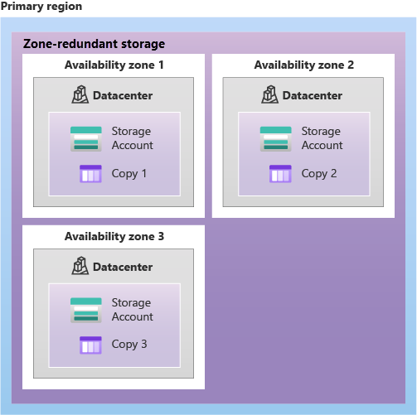
Zone-redundant storage
For Availability Zone-enabled Regions,
zone-redundant storage (ZRS) replicates your
Azure Storage data synchronously across
three Azure availability zones in the
primary region. ZRS offers durability for
Azure Storage data objects of at least
12 nines (99.9999999999%) over a given year.

Slide 9
Redundancy in a secondary region
You can choose to additionally copy the data in your storage account to a secondary region that is hundreds of miles away from the primary region
Data is durable even in the event of a catastrophic failure that prevents the data in the primary region from being recovered
When you create a storage account, you select the primary region for the account.
Two options for copying your data to a secondary region:
geo-redundant storage (GRS)
geo-zone-redundant storage (GZRS)

Slide 10
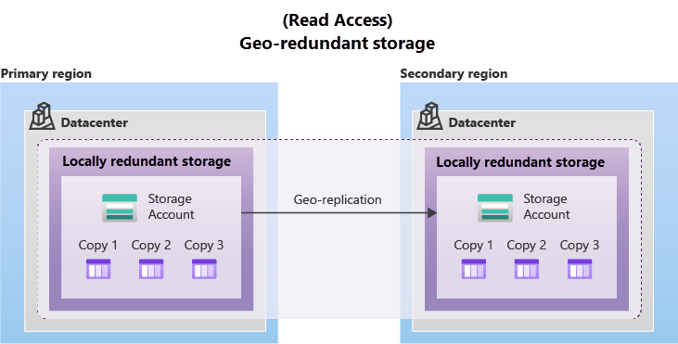
Geo-redundant storage
GRS copies your data synchronously three times within a single physical location in the primary region using LRS. It then copies your data asynchronously to a single physical location in the secondary region (the region pair) using LRS.

Slide 11
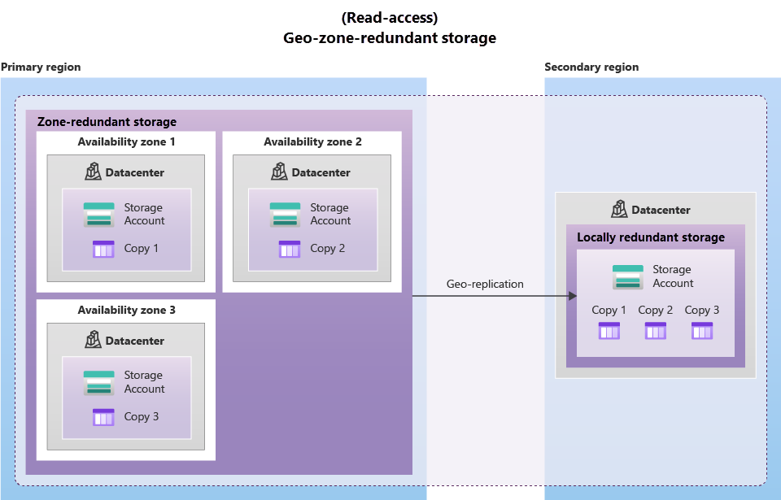
Geo-zone-redundant storage
GZRS combines the high availability provided by redundancy across availability zones with protection from regional outages provided by geo-replication.

Slide 12
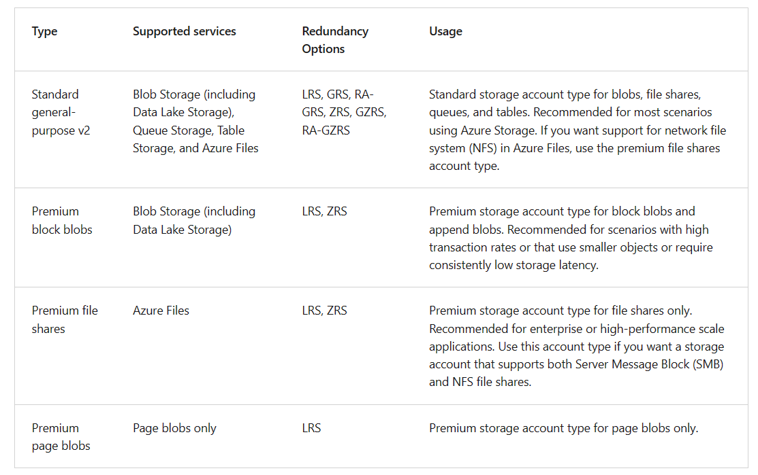
Azure storage accounts

Slide 13





Azure storage services
Azure Blob: Optimized for storing massive amounts of unstructured data, such as text or binary data.
Azure Disk: Provides disks for virtual machines, applications, and other services to access and use.
Azure Queue: Message storage service that provides storage and retrieval for large amounts of messages, each up to 64 KB.
Azure Files: Sets up a highly available network file share that can be accessed by using the Server Message Block protocol.
Azure Tables: Provides a key/attribute option for structured nonrelational data storage with a schema-less design.
Notes:
https://learn.microsoft.com/training/modules/describe-azure-storage-services/4-describe-azure-storage-services

Slide 14
Storage service public endpoints
Storage service | Public endpoint
Blob Storage | https://<storage-account-name>.blob.core.windows.net
Data Lake Storage Gen2 | https://<storage-account-name>.dfs.core.windows.net
Azure Files | https://<storage-account-name>.file.core.windows.net
Queue Storage | https://<storage-account-name>.queue.core.windows.net
Table Storage | https://<storage-account-name>.table.core.windows.net

Slide 15
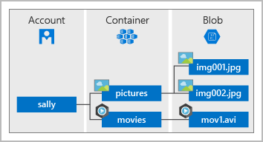
Benefits of Azure Storage
Azure Storage services offer the following benefits for application developers and IT professionals:
Durable and highly available
Secure
Scalable
Managed
Accessible

Slide 16

Blob Storage
An object storage solution for the cloud
It can store massive amounts of data, such as text or binary data
Unstructured->no restrictions on the kinds of data it can hold
It can manage thousands of simultaneous uploads
Data is uploaded as blobs, and Azure takes care of the physical storage needs

Slide 17
Blob Storage
Ideal for:
Serving images or documents directly to a browser.
Storing files for distributed access.
Streaming video and audio.
Storing data for backup and restore, disaster recovery, and archiving.
Storing data for analysis by an on-premises or Azure-hosted service.

Slide 18
Azure storage access tiers
Hot | Cool | Cold | Archive
Optimized for storing data that is accessed frequently. | Optimized for storing data that is infrequently accessed and stored for at least 30 days. | Optimized for storing data that is infrequently accessed and stored for at least 90 days. | Optimized for storing data that is rarely accessed and stored for at least 180 days with flexible latency requirements.
Notes:
https://learn.microsoft.com/training/modules/describe-azure-storage-services/4-describe-azure-storage-services

Slide 19
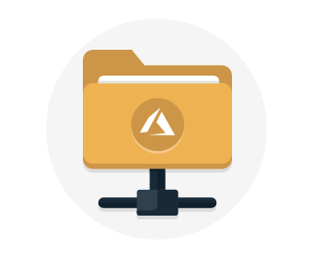
Azure Files
Offers fully managed file shares in the cloud that are accessible via the industry standard Server Message Block and Network File System (preview) protocols.
Azure file shares can be mounted concurrently by cloud or on-premises deployments of Windows, Linux, and macOS.
Applications running in Azure virtual machines or cloud services can mount a file storage share to access file data.
Any number of Azure virtual machines or roles can mount and access the file storage share simultaneously.
Usage: share files anywhere in the world, diagnostic data, or application data sharing.

Slide 20
Azure Files key benefits
Shared access
Fully managed
Scripting and tooling
Resiliency
Familiar programmability

Slide 21
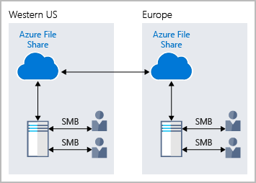
Azure Files

Slide 22
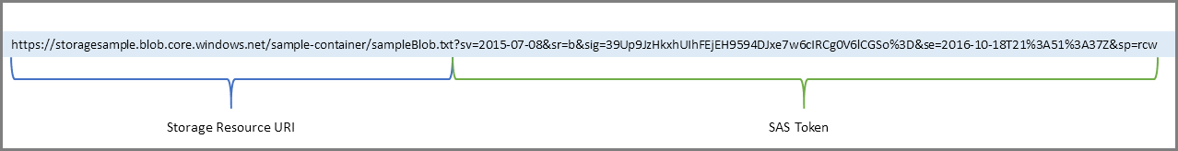
Azure Files
One thing that distinguishes Azure Files from files on a corporate file share is that you can access the files from anywhere in the world, by using a URL that points to the file.

Slide 23
Queue Storage
Azure Queue Storage is a service for storing large numbers of messages.
Once stored, you can access the messages from anywhere in the world via authenticated calls using HTTP or HTTPS.
A queue can contain as many messages as your storage account has room for (potentially millions).
Each individual message can be up to 64 KB in size.

Slide 24
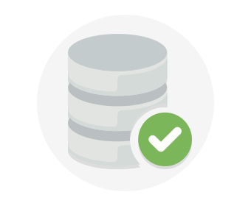
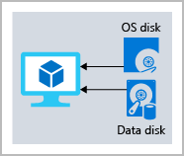
Disk storage
Disk Storage provides disks for Azure virtual machines -> similar to how they would in on-premises scenarios.
Disk Storage allows data to be persistently stored and accessed from an attached virtual hard disk.
Disks come in many different sizes and performance levels, from solid-state drives (SSDs) to traditional spinning hard disk drives (HDDs), with varying performance tiers.

Slide 25

Azure Migrate
Unified migration platform.
Range of integrated and standalone tools.
Assessment and migration.
Notes:
https://learn.microsoft.com/training/modules/describe-azure-storage-services/6-identify-azure-data-migration-options

Slide 26
Integrated tools
Azure Migrate hub also includes the following tools to help with migration:
Azure Migrate: Discovery and assessment.
Azure Migrate: Server Migration.
Data Migration Assistant.
Azure Database Migration Service
Web app migration assistant
Azure Data Box

Slide 27

Azure Data Box
Store up to 80 terabytes of data.
Move your disaster recovery backups to Azure.
Protect your data in a rugged case during transit.
Migrate data out of Azure for compliance or regulatory needs.
Migrate data to Azure from remote locations with limited or no connectivity.
Notes:
https://learn.microsoft.com/training/modules/describe-azure-storage-services/6-identify-azure-data-migration-options

Slide 28
Azure Data Box
Use cases:
Data Box is ideally suited to transfer data sizes larger than 40 TBs in scenarios with no to limited network connectivity.
Data Box can be used to import data to Azure:
Onetime migration - when a large amount of on-premises data is moved to Azure.
Moving a media library from offline tapes into Azure to create an online media library.
Migrating your VM farm, SQL server, and applications to Azure.
Moving historical data to Azure for in-depth analysis and reporting using HDInsight.
Initial bulk transfer - when an initial bulk transfer is done using Data Box (seed) followed by incremental transfers over the network.
Periodic uploads - when large amount of data is generated periodically and needs to be moved to Azure.

Slide 29
Azure Data Box
Data Box can be used to export data from Azure:
Disaster recovery - when a copy of the data from Azure is restored to an on-premises network. In a typical disaster recovery scenario, a large amount of Azure data is exported to a Data Box. Microsoft then ships this Data Box, and the data is restored on your premises in a short time.
Security requirements - when you need to be able to export data out of Azure due to government or security requirements.
Migrate back to on-premises or to another cloud service provider - when you want to move all the data back to on-premises, or to another cloud service provider, export data via Data Box to migrate the workloads.

Slide 30
File management options
AzCopy
Azure Storage Explorer
Azure File Sync
Command-line utility.
Copy blobs or files to or from your storage account.
One-direction synchronization.
Graphical user interface (similar to Windows Explorer).
Compatible with Windows, MacOS, and Linux.
Uses AzCopy to handle file operations.
Synchronizes Azure and on-premises files in a bidirectional manner.
Cloud tiering keeps frequently accessed files local, while freeing up space.
Rapid reprovisioning of failed local server (install and resync).
Notes:
https://learn.microsoft.com/training/modules/describe-azure-storage-services/7-identify-azure-file-movement-options

Slide 31
Azure File Sync
With Azure File Sync, you can:
Use any protocol that's available on Windows Server to access your data locally, including SMB, NFS, and FTPS.
Have as many caches as you need across the world.
Replace a failed local server by installing Azure File Sync on a new server in the same datacenter.
Configure cloud tiering so the most frequently accessed files are replicated locally, while infrequently accessed files are kept in the cloud until requested.

Slide 32
Questions
Which tool automatically keeps files between an on-premises Windows server and an Azure cloud environment updated?
Azure File Sync
Azure Storage Explorer
AzCopy

Slide 33
Questions
2. Which storage redundancy option provides the highest degree of durability, with 16 nines of durability?
Locally redundant storage
Zone-redundant storage
Geo-zone-redundant-storage

Slide 34
Questions
3. Which Azure Storage service supports big data analytics, as well as handling text and binary data types?
Azure Blobs
Azure Files
Azure Disks

